Slide 1

Detecting COR_PROFILER Manipulation

Slide 2
Basic Concepts
Common Language Runtime (CLR), Profiler, Dynamic-Link Library (DLL), Environment Variables, Windows Registry, Access Control List (ACL), and System Access Control List (SACL)

Slide 3
What is a Common Language Runtime Profiler?
Allows any .NET program to get executed
CLR Common Language Runtime
CLR start and shutdown events
A Dynamic-Link Library (DLL) or set of functions that receive messages from, and send messages to, the CLR
CLR Profiler
Module loading and unloading events
Tool that monitors the execution of another application
Profiler
Thread creation and destruction events
https://docs.microsoft.com/en-us/dotnet/standard/clr https://docs.microsoft.com/en-us/dotnet/framework/unmanaged-api/profiling/profiling-overview

Slide 4
How does CLR Profiler work?
start
If variables are set
.NET application
loads
CLR
evaluates
Environment Variables
loads
Profiler DLL
COR_ENABLE_PROFILING Value set to 1
COR_PROFILER Class Id (CLSID) to identify DLL
“To profile a CLR application, you must set the COR_ENABLE_PROFILING and COR_PROFILER environment variables before you run the application. You must also make sure that the profiler DLL is registered”
https://docs.microsoft.com/en-us/dotnet/framework/unmanaged-api/profiling/setting-up-a-profiling-environment

Slide 5
How do we set Environment variables Values ?
System-defined database in which applications and system components store and retrieve configuration data
Windows Registry
Scope
HKLM\SYSTEM\CurrentControlSet\Control\Session Manager\Environment
Machine
Noisy
HKCU\Environment and/or HKU\SomeSID\Environment
User
Registry path to a Process (Application or Service)
Process
Targeted
HKLM\SYSTEM\CurrentControlSet\Services\SomeServiceName
and more
https://docs.microsoft.com/en-us/windows/win32/sysinfo/registry https://docs.microsoft.com/en-us/dotnet/framework/unmanaged-api/profiling/setting-up-a-profiling-environment

Slide 6
How do we register a Profiler DLL?
Using the InprocServer registry entry, which specifies the path to an in-process server DLL.
Using the COR_PROFILER_PATH environment variable that was added with .NET Framework 4 to specify the full path of the profiler DLL. If COR_PROFILER_PATH is set, any arbitrary CLSID can be used for the COR_PROFILER environment variable.
More options …
https://docs.microsoft.com/en-us/windows/win32/com/inprocserver
https://redcanary.com/blog/cor_profiler-for-persistence/

Slide 7
Wait … why is this relevant?
To identify the relationship among different actions that need to be performed in our network environment → BEHAVIOR
DLL creation
DLL registration
Environment variables setting
DLL loading
t
COR_ENABLE_PROFILING & COR_PROFILER
Computer, user, or process scope

Slide 8
Access Control List (ACL)
“An access control list (ACL) is a list of access control entries (ACE). Each ACE in an ACL identifies a trustee and specifies the access rights allowed, denied, or audited for that trustee. The security descriptor for a securable object can contain two types of ACLs: a DACL and a SACL.”
https://docs.microsoft.com/en-us/windows/win32/secauthz/access-control-lists

Slide 9
Discretionary Access Control List (DACL)
“A discretionary access control list (DACL) identifies the trustees that are allowed or denied access to a securable object. When a process tries to access a securable object, the system checks the ACEs in the object's DACL to determine whether to grant access to it. If the object does not have a DACL, the system grants full access to everyone. If the object's DACL has no ACEs, the system denies all attempts to access the object because the DACL does not allow any access rights. The system checks the ACEs in sequence until it finds one or more ACEs that allow all the requested access rights, or until any of the requested access rights are denied.”
https://docs.microsoft.com/en-us/windows/win32/secauthz/access-control-lists

Slide 10
System Access Control List (SACL)
“A system access control list (SACL) enables administrators to log attempts to access a secured object. Each ACE specifies the types of access attempts by a specified trustee that cause the system to generate a record in the security event log. An ACE in a SACL can generate audit records when an access attempt fails, when it succeeds, or both.”
https://docs.microsoft.com/en-us/windows/win32/secauthz/access-control-lists

Slide 11
Network Environment
What are we protecting?

Slide 12
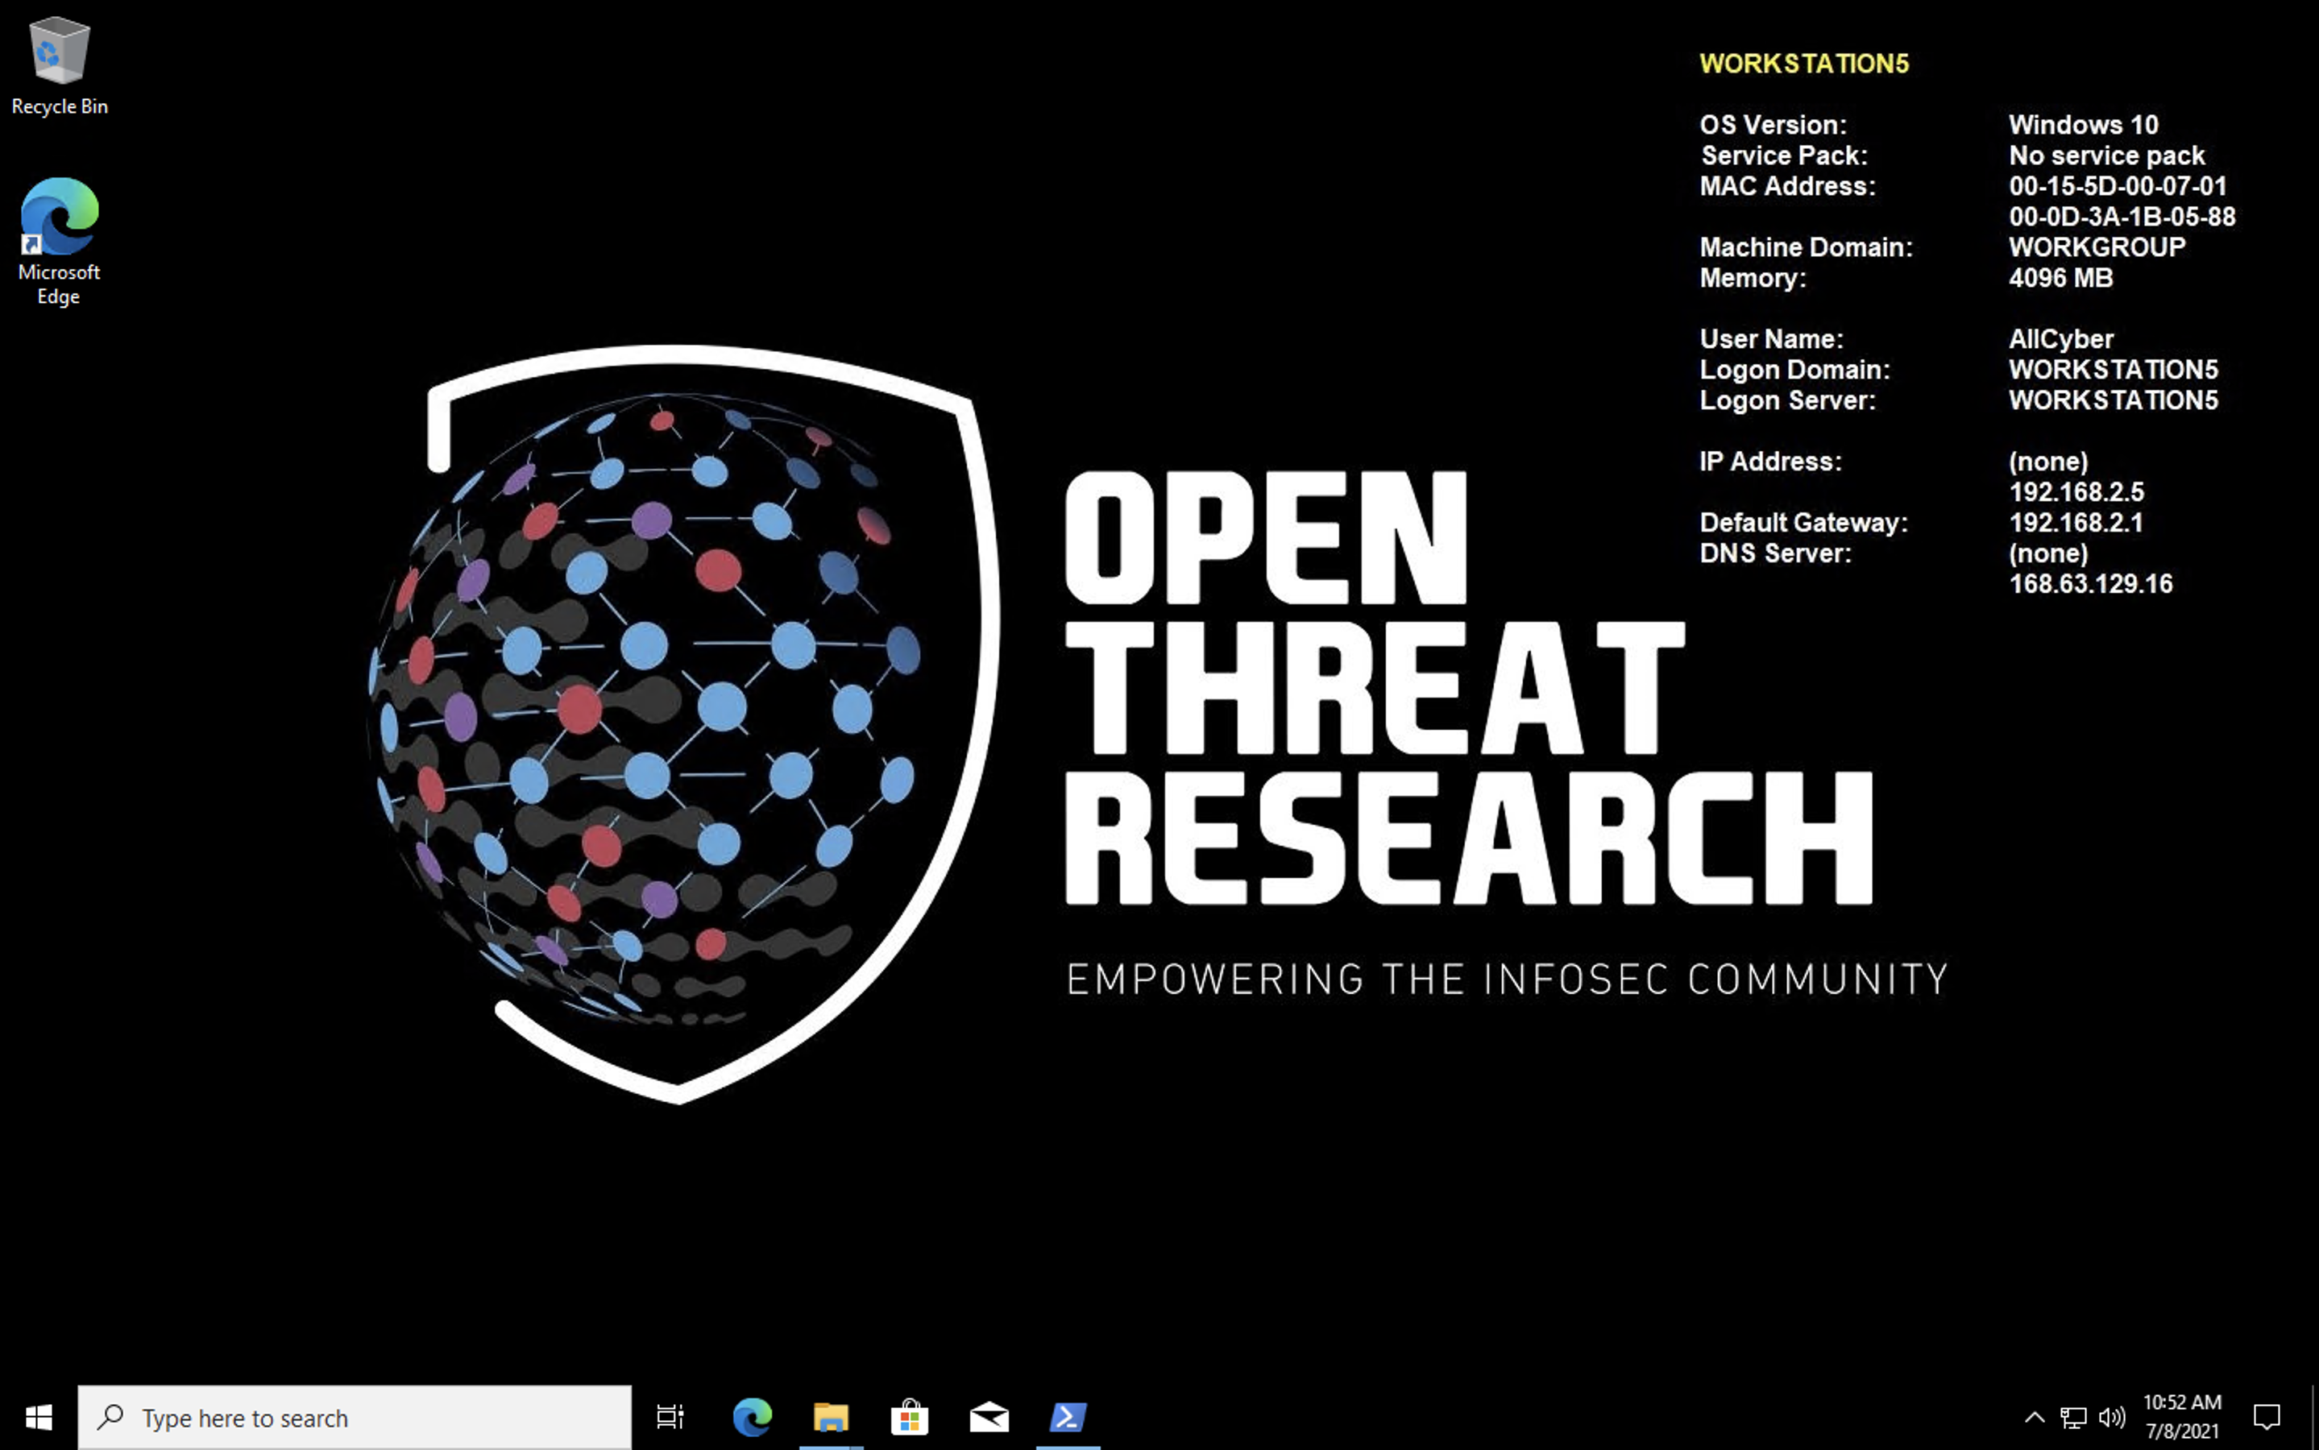
Workstation for a Regular User: Windows 10

Slide 13
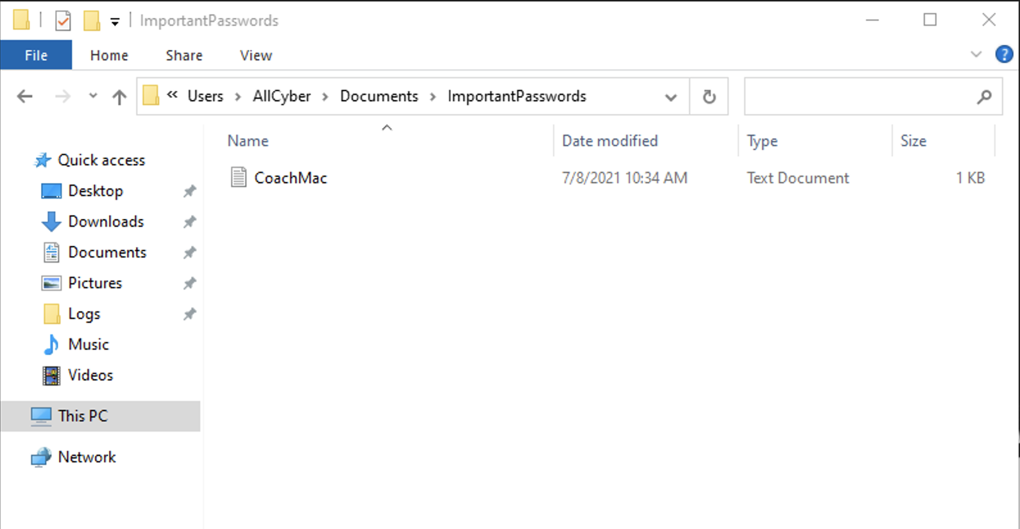
Important File: Coach Mac Passwords

Slide 14
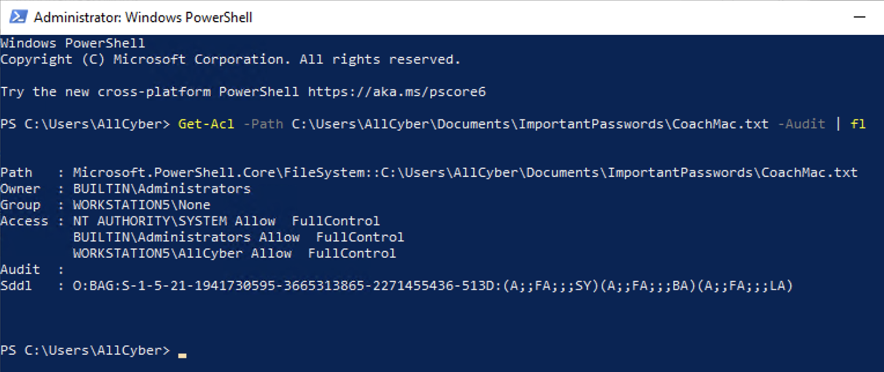
Important File: Coach Mac Passwords

Slide 15
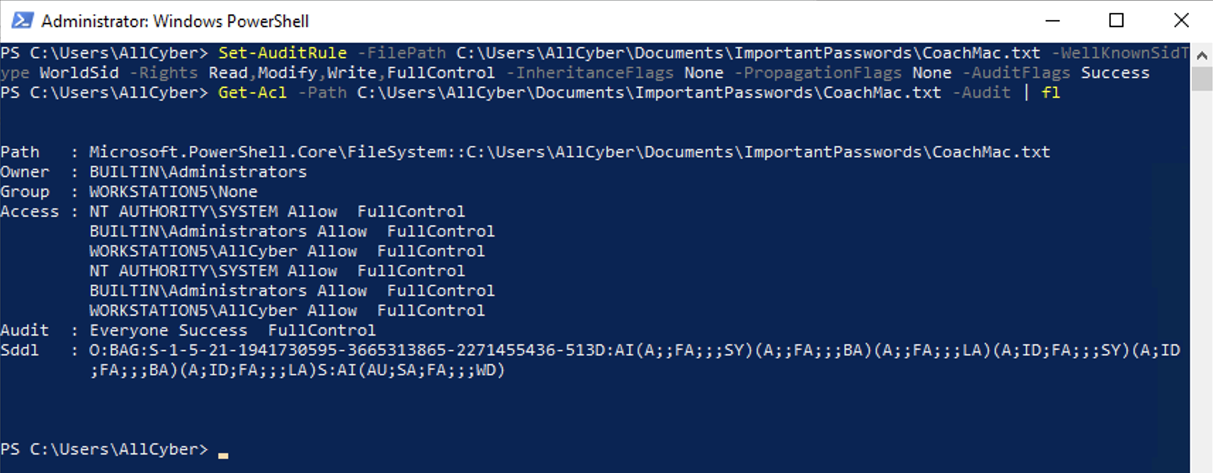
Important File: Coach Mac Passwords

Slide 16
Detection Research Methodology
A data-driven approach

Slide 17
Our main reference the past weeks!!
Research Goal Definition
Adversary Tradecraft Understanding
Telemetry Collection and Documentation
Data Analysis and Modeling
Detection Research Sharing
Detection Strategy Validation & Documentation

Slide 18

Our main reference the past weeks!!
Research Goal Definition
Adversary Tradecraft Understanding
Telemetry Collection and Documentation
Data Analysis and Modeling
Detection Research Sharing
Detection Strategy Validation & Documentation
Tyler helped us to get a better understanding of the adversary tradecraft last week

Slide 19

Our main reference the past weeks!!
Research Goal Definition
Adversary Tradecraft Understanding
Telemetry Collection and Documentation
Data Analysis and Modeling
Detection Research Sharing
Detection Strategy Validation & Documentation
Today, we will focus on explaining these other steps

Slide 20
Hypothesis Definition
Research Goal Definition
Adversary Tradecraft Understanding
Telemetry Collection and Documentation
Data Analysis and Modeling
Detection Research Sharing
Detection Strategy Validation & Documentation
Threat intelligence, business goals, hypothesis

Slide 21
Threat Intelligence: Profiler DLL Behavior
DLL creation
DLL registration
Environment variables setting
DLL loading
t
COR_ENABLE_PROFILING & COR_PROFILER
Computer, user, or process scope

Slide 22
Profiler DLL Behavior → Abusing COR_PROFILER
Bypass User Account Control
DLL creation
DLL registration
Environment variables setting
DLL loading
Persistence
Bypass AppLocker Restrictions
t
COR_ENABLE_PROFILING & COR_PROFILER
Computer, user, or process scope

Slide 23
Profiler DLL Behavior → Abusing COR_PROFILER
Bypass User Account Control
DLL creation
DLL registration
Environment variables setting
DLL loading
Persistence
Bypass AppLocker Restrictions
t
COR_ENABLE_PROFILING & COR_PROFILER
Computer, user, or process scope

Slide 24
Hypothesis Definition
Adversaries may be manipulating environment variables (COR_PROFILER) to register a malicious Dynamic-Link Library (DLL) and hijack the execution flow of programs that load the .NET Common Language Runtime (CLR) in order to persist in a network environment.

Slide 25
Adversary Tradecraft Understanding
Research Goal Definition
Adversary Tradecraft Understanding
Telemetry Collection and Documentation
Data Analysis and Modeling
Detection Research Sharing
Detection Strategy Validation & Documentation
Offensive Security Tools (OST), Static & Dynamic Analysis, Initial Data Modeling

Slide 26
Initial Data Modeling
manipulating environment variables
register a malicious DLL
persist in a network environment.

Slide 27
Initial Data Modeling
Registry Key
manipulating environment variables
register a malicious DLL
persist in a network environment.
Process
created or modified
Registry Key Value
Process
DLL
created & loaded
Process
Ip
connected to

Slide 28
Identification of Telemetry
Registry Key
created or modified
Registry Key Value
Process
DLL
created & loaded
Ip
connected to

Slide 29
Identification of Telemetry – Sysmon/Operational
Registry Key
Sysmon Event 13
This Registry event type identifies Registry value modifications. The
event records the value written for Registry values of type DWORD and QWORD.
created or modified
Registry Key Value
Sysmon Event 14
Registry key and value rename operations map to this event type, recording the new name of the key or value that was renamed.
Sysmon Event 11
File create operations are logged when a file is created or overwritten.
Process
DLL
created & loaded
Sysmon Event 7
The image loaded event logs when a module is loaded in a specific process.
Ip
Sysmon Event 3
The network connection event logs TCP/UDP connections on the machine.
connected to

Slide 30
Telemetry Collection and Documentation
Research Goal Definition
Adversary Tradecraft Understanding
Telemetry Collection and Documentation
Data Analysis and Modeling
Detection Research Sharing
Detection Strategy Validation & Documentation
Data Dictionaries, Adversary Simulation, Data Collection

Slide 31
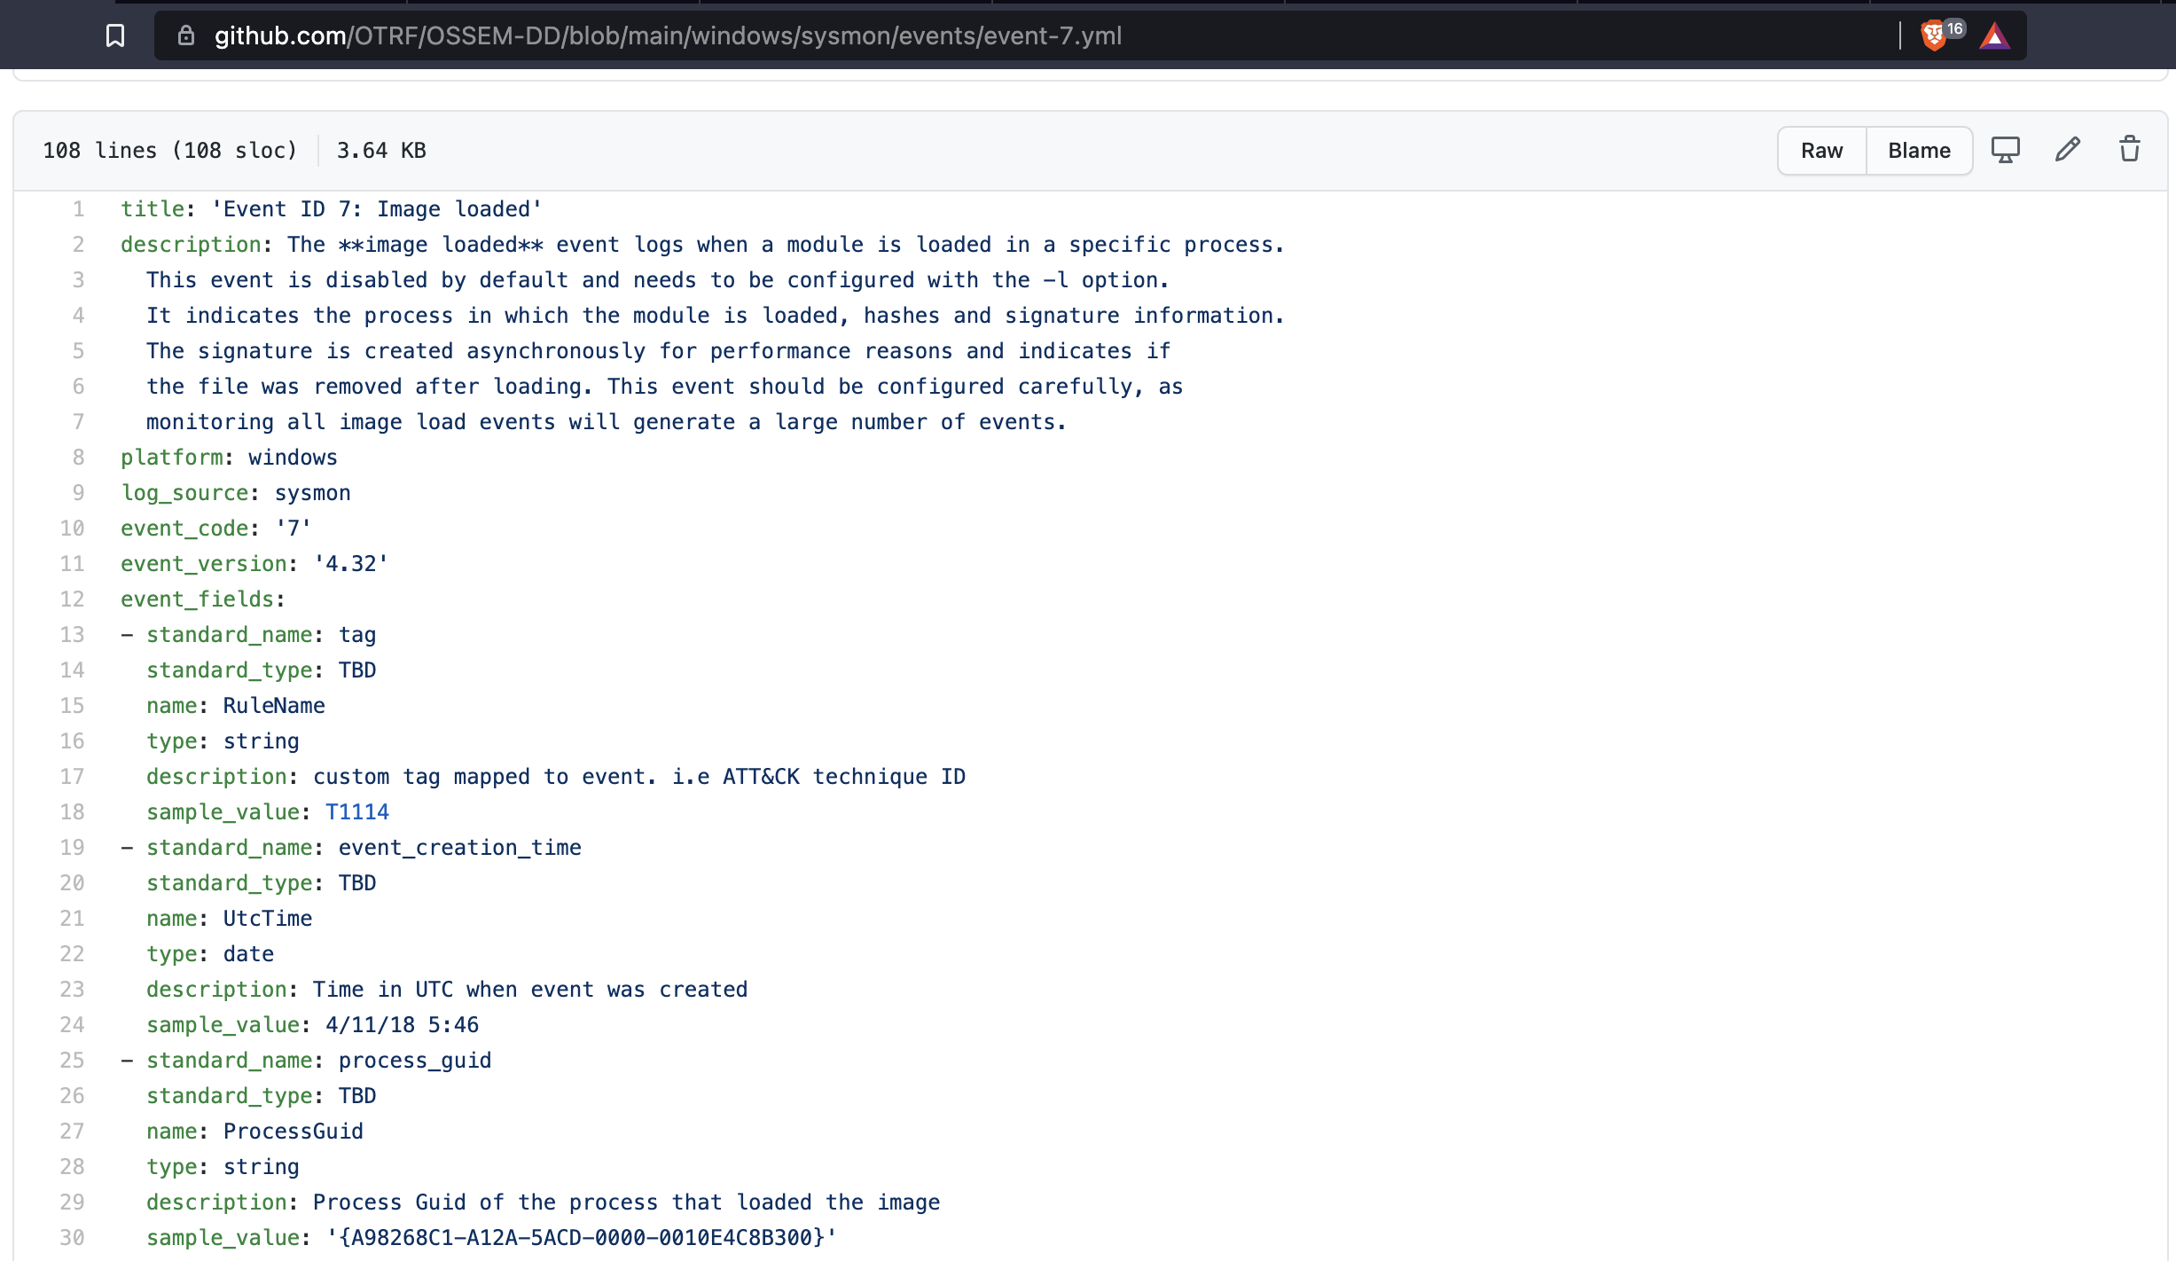

Data Dictionaries - OSSEM
https://github.com/OTRF/OSSEM-DD https://github.com/OTRF/OSSEM-DD/blob/main/windows/sysmon/events/event-7.yml

Slide 32
Adversary Simulation: Persistence
Before rebooting workstation
After rebooting workstation

Slide 33
Adversary Simulation: Persistence
Before rebooting workstation
After rebooting workstation
Registry Key
DLL
loaded
created or modified
Process
Registry Key Value
Process
Ip
connected to
DLL
created

Slide 34
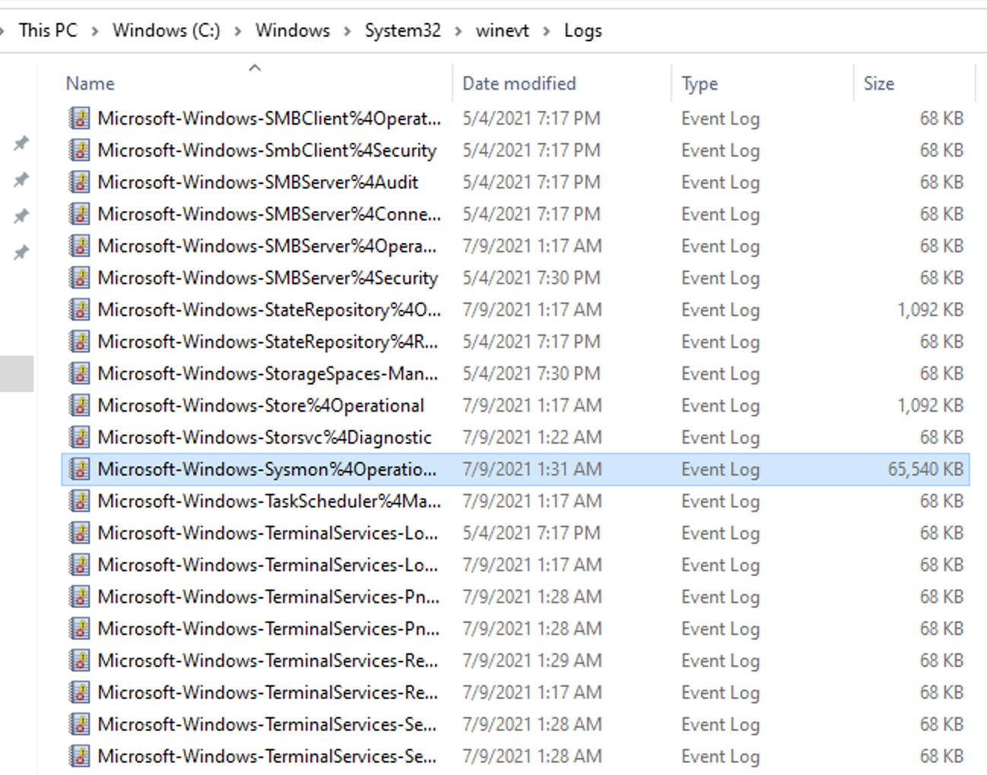
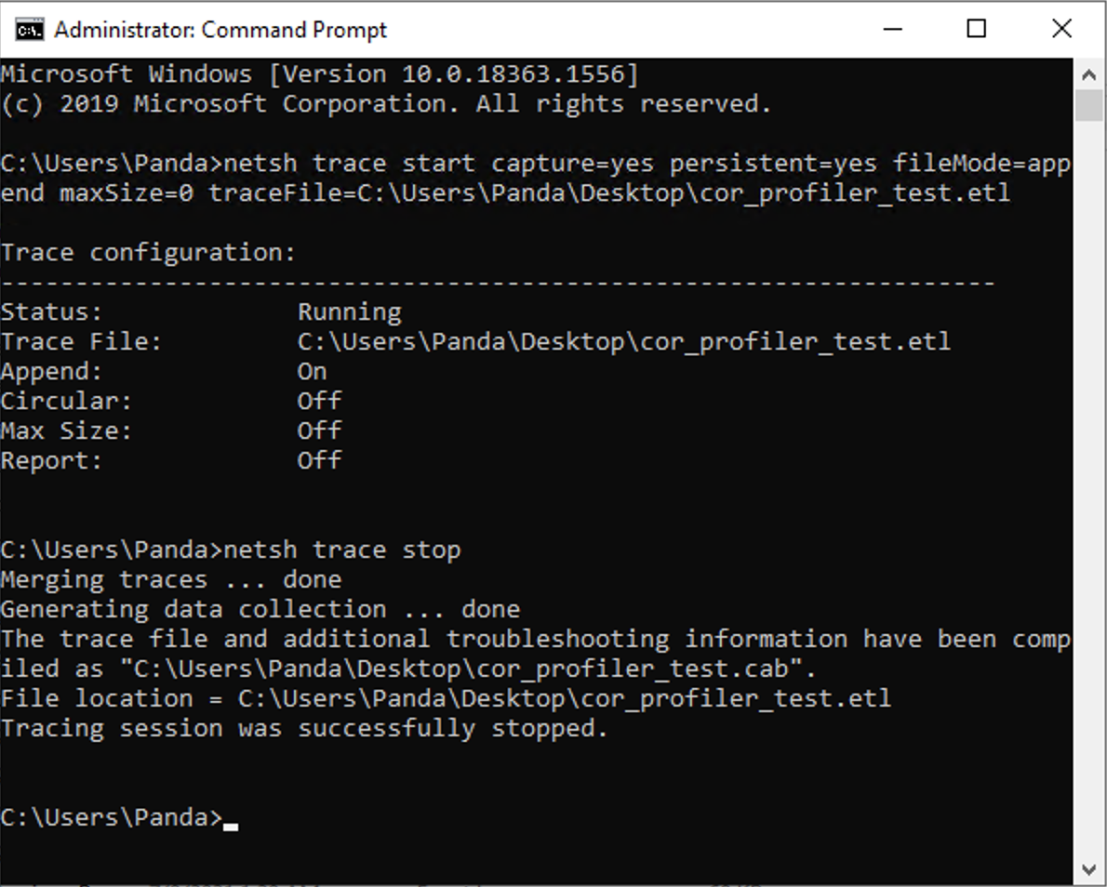
Data Collection
Host – EVTX files
Network – Event Trace Logs files
https://medium.com/threat-hunters-forge/mordor-pcaps-part-1-capturing-network-packets-from-windows-endpoints-with-network-shell-e117b84ec971

Slide 35
Data Analysis and Modeling
Research Goal Definition
Adversary Tradecraft Understanding
Telemetry Collection and Documentation
Data Analysis and Modeling
Detection Research Sharing
Detection Strategy Validation & Documentation
Preparation, Summarize & Filter, Correlate, Visualize

Slide 36
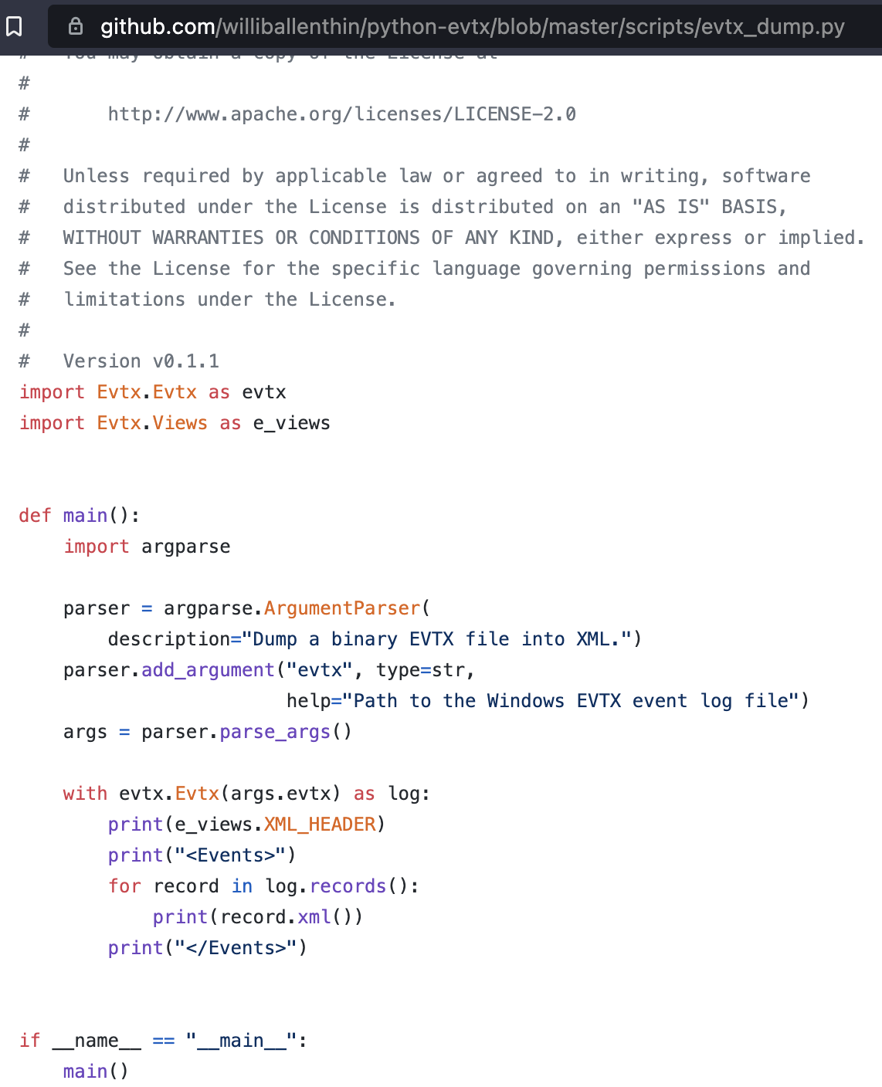
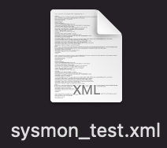
Preparation of Host Data: EVTX → XML
https://github.com/williballenthin/python-evtx

Slide 37
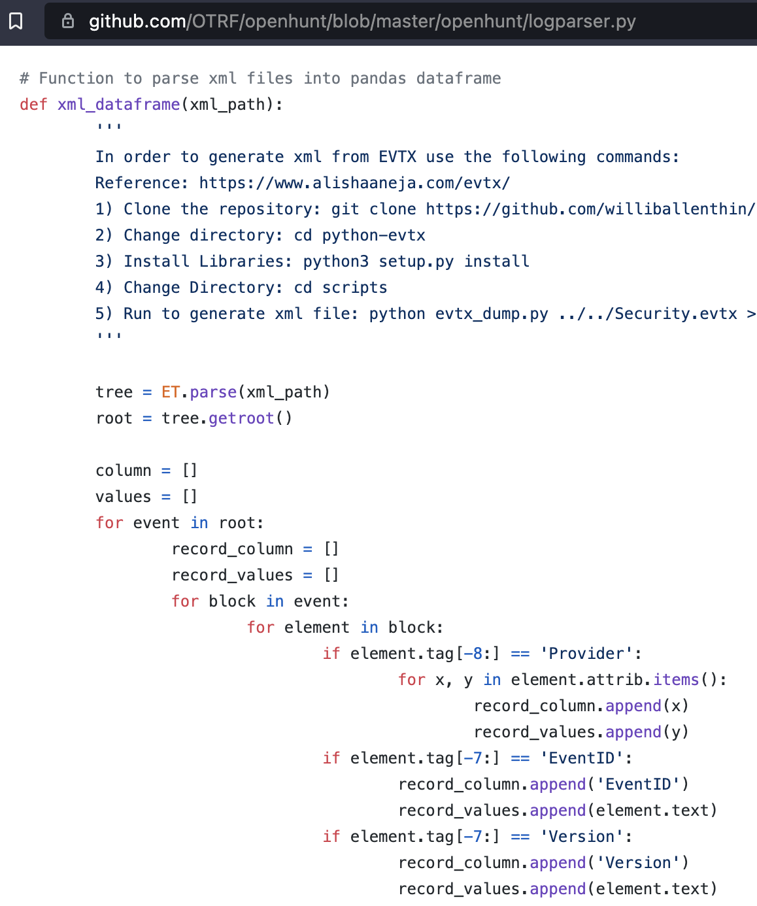
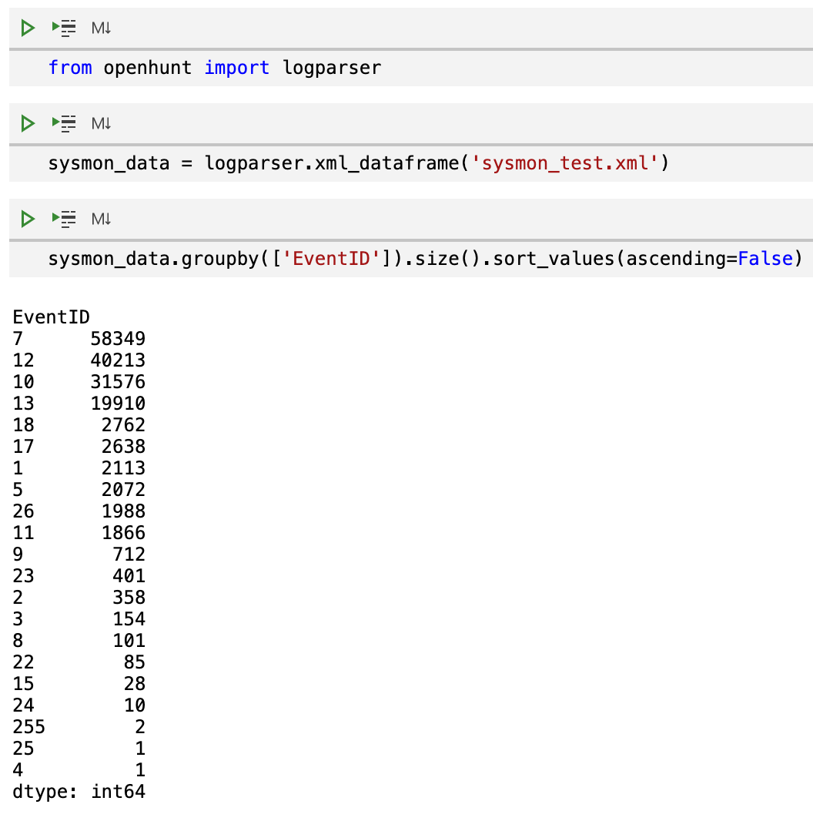
Preparation of Host Data: XML → Pandas dataframe
https://github.com/OTRF/openhunt/blob/master/openhunt/logparser.py

Slide 38
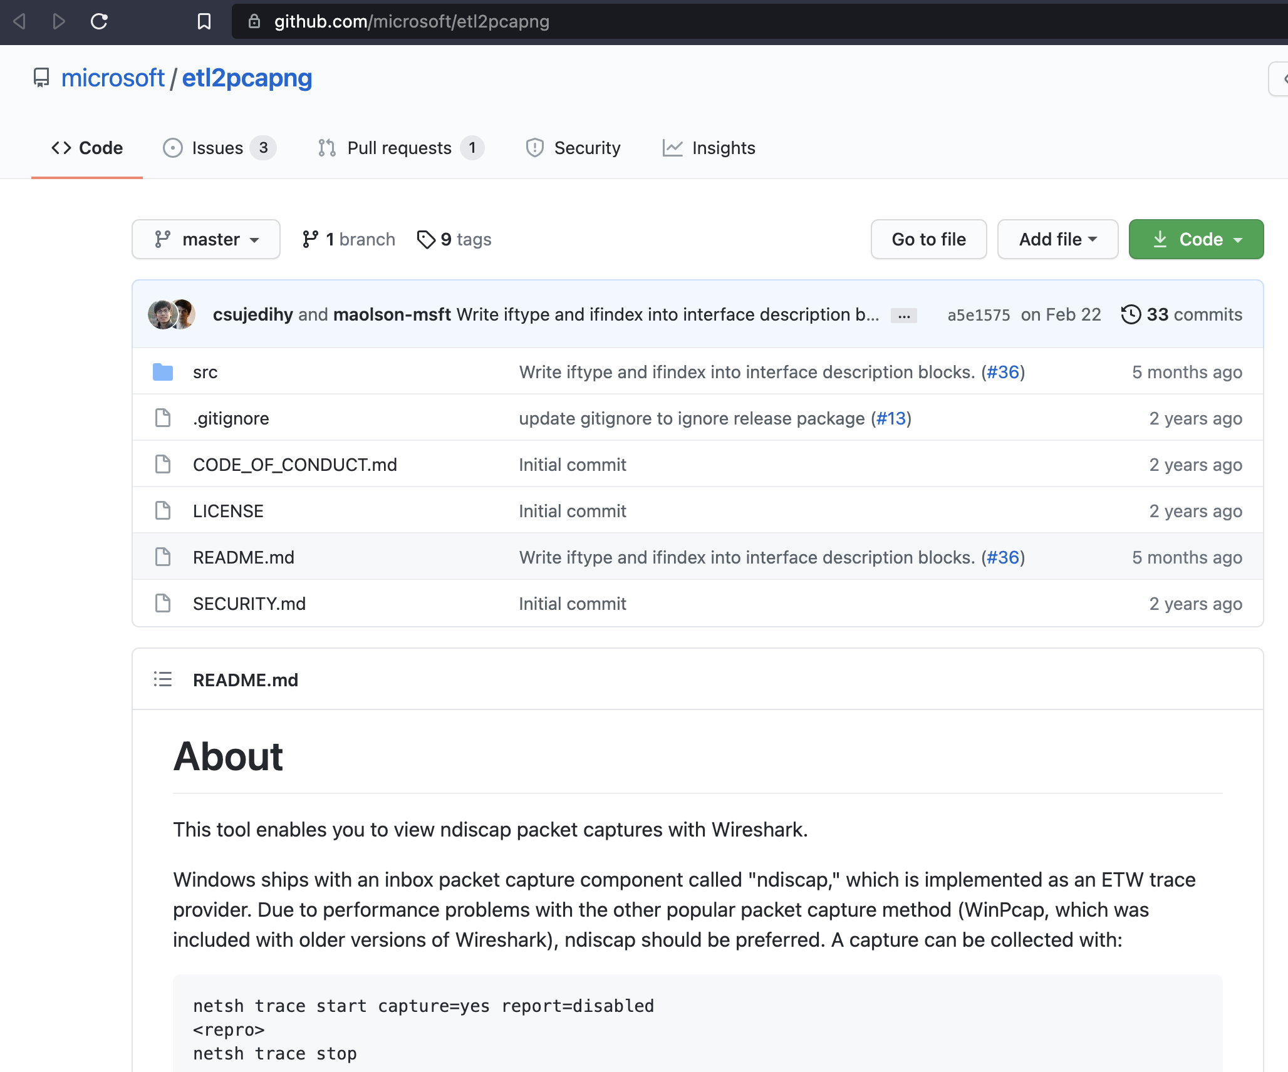
Preparation of Network Data: ETL → PCAP
https://github.com/microsoft/etl2pcapng

Slide 39
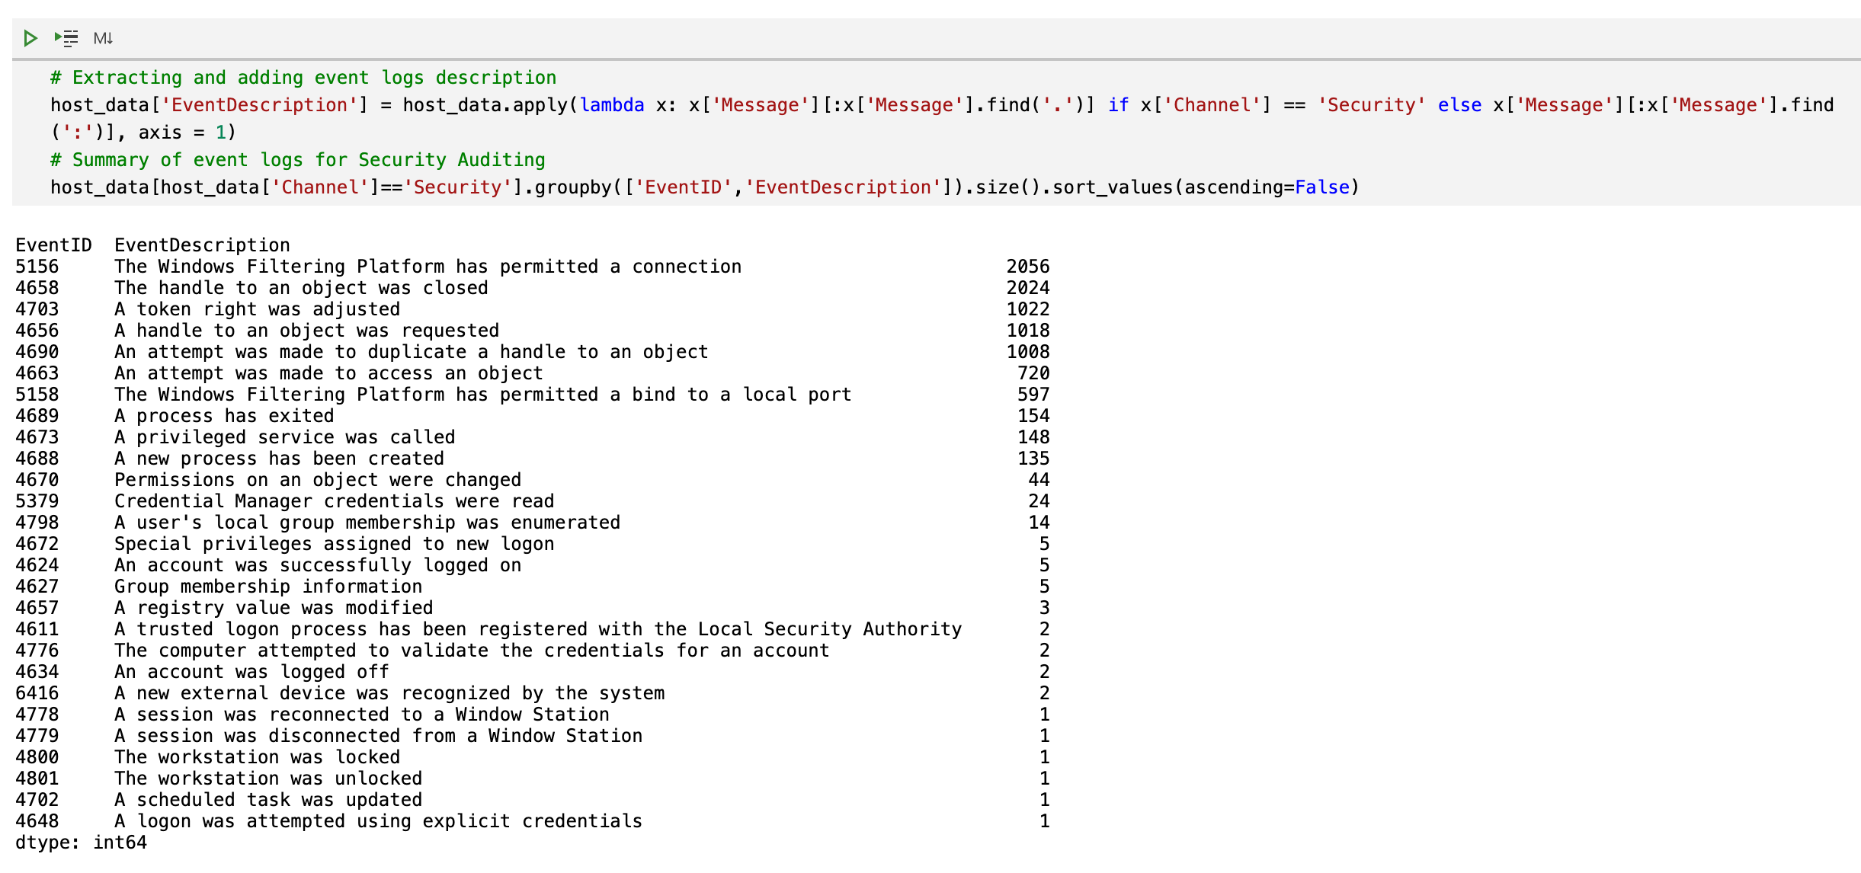
Data Analysis using Python / Jupyter Notebooks

Slide 40
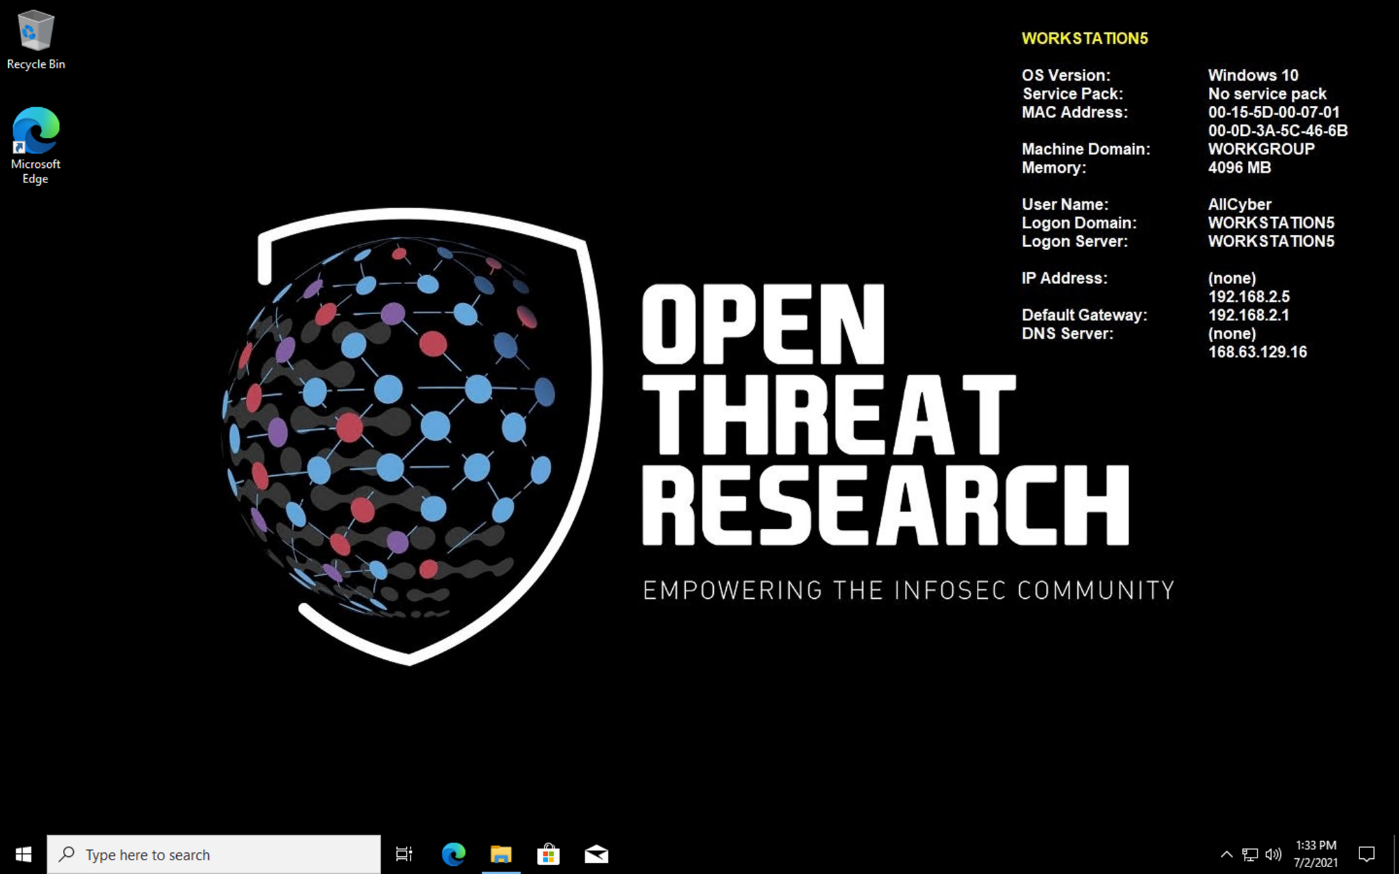
Data Analysis: Before Rebooting

Slide 41
Adversary Simulation: Persistence
Before rebooting workstation
After rebooting workstation
Registry Key
DLL
loaded
created or modified
Process
Registry Key Value
Process
Ip
connected to
DLL
created

Slide 42
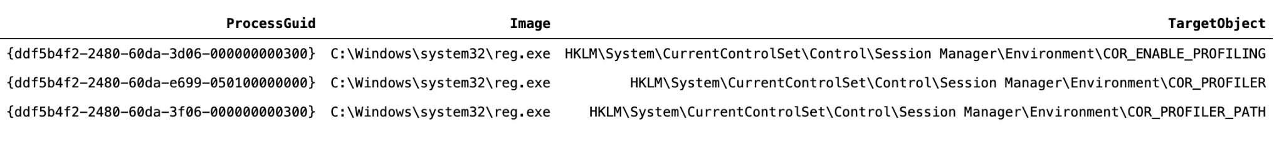
1) Looking for Modification of Registry Keys
Test 2: Sysmon event 13 (Registry key value modification)

Slide 43

1) Looking for Modification of Registry Keys
Test 2: Sysmon event 13 (Registry key value modification)
Test 3: No Registry keys modification events (COR_PROFILER) were collected

Slide 44

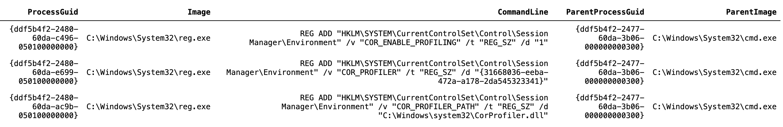
2) Looking for Commands Execution
Test 2: Analyzing Command Line execution field of Sysmon event 1 (Process Creation)
Test 3: Analyzing Command Line execution field of Sysmon event 1 (Process Creation)

Slide 45
2) Looking for Commands Execution
Test 2: Analyzing Command Line execution field of Sysmon event 1 (Process Creation)
Test 3: Analyzing Command Line execution field of Sysmon event 1 (Process Creation)

Slide 46
2) Looking for Commands Execution
Test 2: Analyzing Command Line execution field of Sysmon event 1 (Process Creation)
Test 3: Analyzing Command Line execution field of Sysmon event 1 (Process Creation)

Slide 47
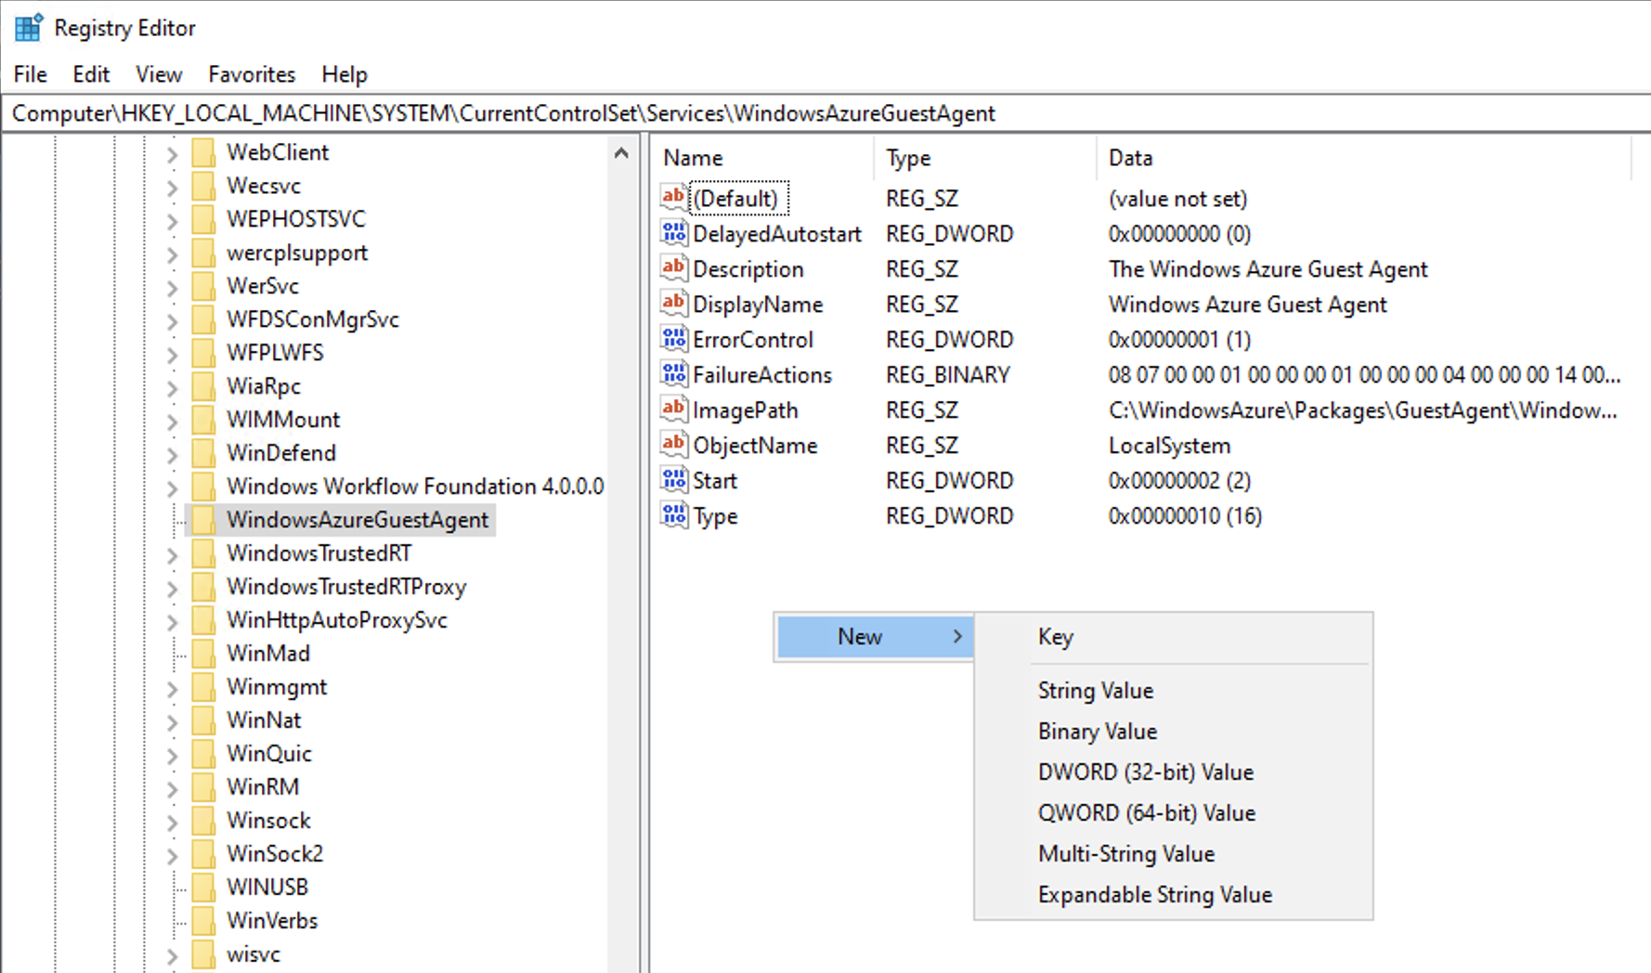
2) Looking for Commands Execution
Not 100% sure, but it looks like the type of variable used when setting a registry key value can affect the way Sysmon logs registry key values modifications.

Slide 48
2) Looking for Commands Execution
Test 2: Analyzing Command Line execution field of Sysmon event 1 (Process Creation)
Test 3: Analyzing Command Line execution field of Sysmon event 1 (Process Creation)

Slide 49
2) Looking for Commands Execution
Test 2: Analyzing Command Line execution field of Sysmon event 1 (Process Creation)
Test 3: Analyzing Command Line execution field of Sysmon event 1 (Process Creation)
Scope of the environment variable: Test 2: Machine or System scope // Test 3: Process scope

Slide 50

(1) Looking for Modification of Registry Keys
Test 2: Sysmon event 13 (Registry key value modification)
Test 3: Sysmon event 13 (Registry key value modification)

Slide 51
Adversary Simulation: Persistence
Before rebooting workstation
After rebooting workstation
Registry Key
DLL
loaded
created or modified
Process
Registry Key Value
Process
Ip
connected to
DLL
created

Slide 52
3) Looking for Potential Malicious DLL File
Test 2: Analyzing Command Line execution field of Sysmon event 1 (Process Creation)
Test 3: Analyzing Command Line execution field of Sysmon event 1 (Process Creation)

Slide 53
3) Looking for DLL File Creation
Test 2: Sysmon event 11 (File Creation)
Test 3: Sysmon event 11 (File Creation)

Slide 54
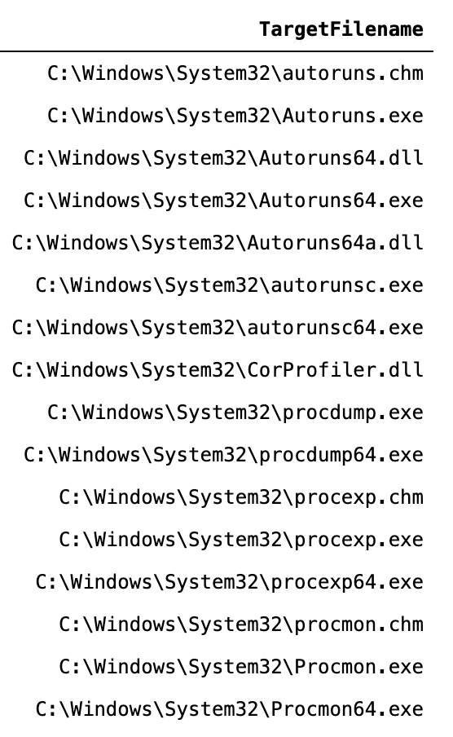
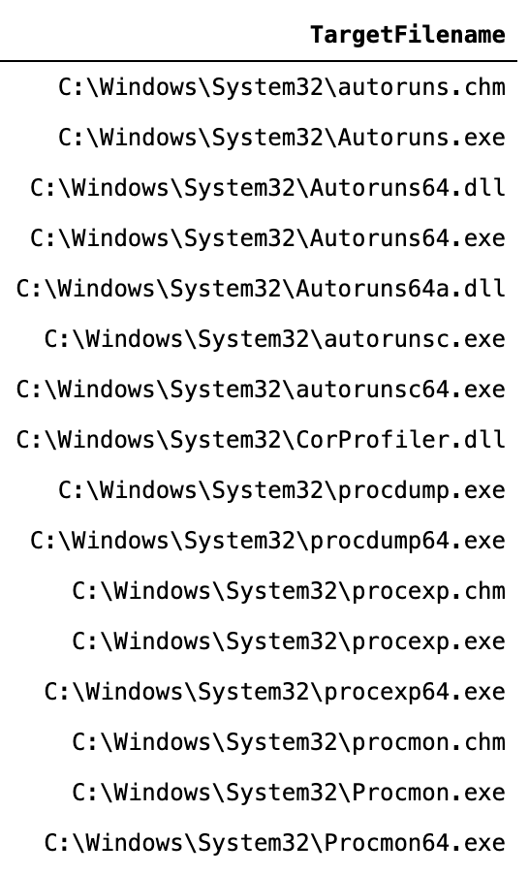
3) Looking for DLL File Creation
Test 2: Sysmon event 11 (File Creation)
Test 2: Sysmon event 11 (File Creation)

Slide 55

Adversary Simulation: Persistence
Before rebooting workstation
After rebooting workstation
Registry Key
DLL
loaded
created or modified
Process
Registry Key Value
Process
Ip
connected to
DLL
created

Slide 56
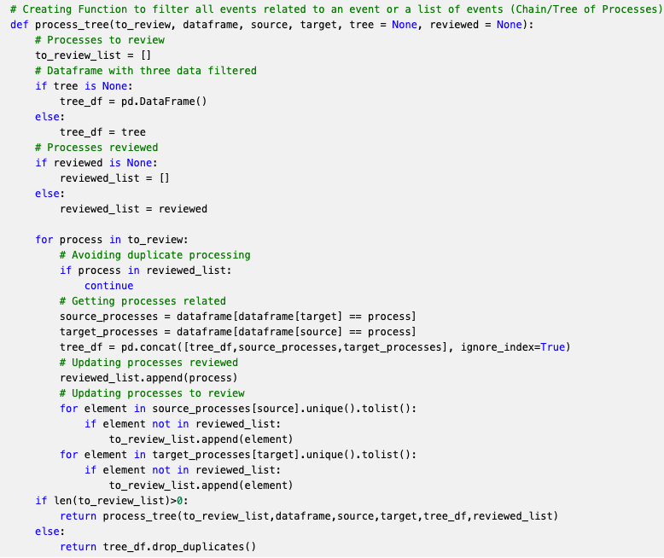
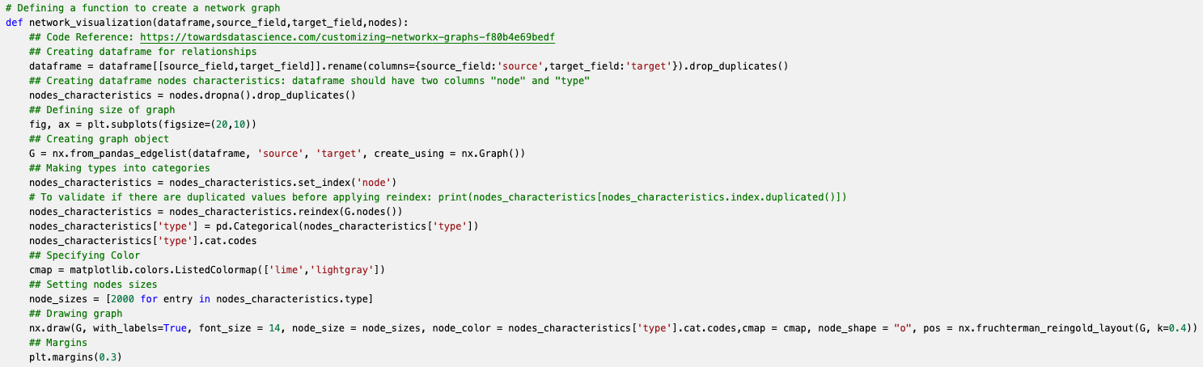
Creating a Tree of Processes

Slide 57
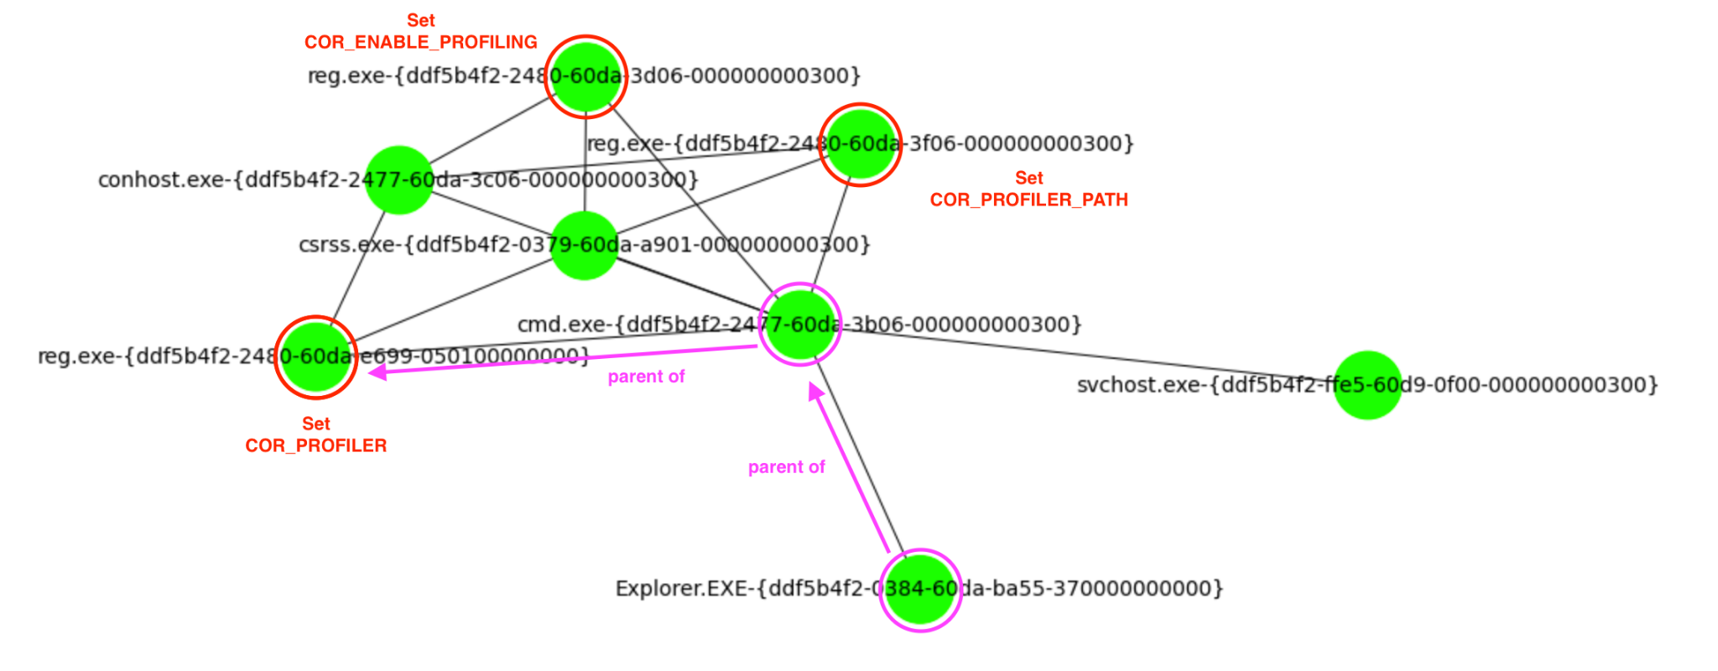
Creating a Tree of Processes: Test 2

Slide 58
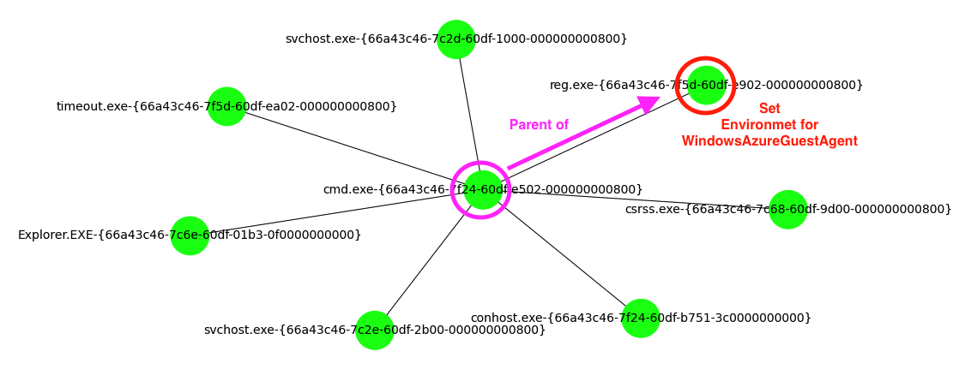
Creating a Tree of Processes: Test 3

Slide 59
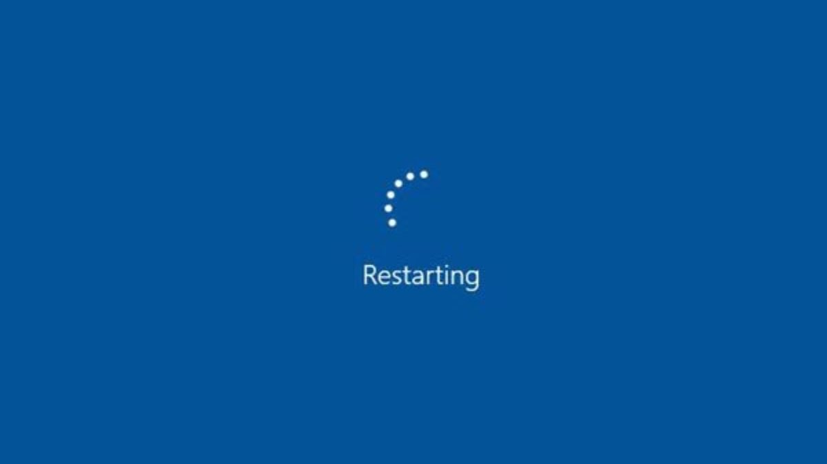
After Rebooting ...

Slide 60
Adversary Simulation: Persistence
Before rebooting workstation
After rebooting workstation
Registry Key
DLL
loaded
created or modified
Process
Registry Key Value
Process
Ip
connected to
DLL
created

Slide 61
4) Looking for DLL being Loaded
Test 2: Sysmon event 7 (Image Loaded)
Test 3: Sysmon event 7 (Image Loaded)

Slide 62
4) Looking for DLL being Loaded
Test 2: Sysmon event 7 (Image Loaded)
Machine/System scope (Noisy), there were more events, but I did not increase the collection size
Test 3: Sysmon event 7 (Image Loaded)

Slide 63
4) Looking for DLL being Loaded
Test 2: Sysmon event 7 (Image Loaded)
Machine/System scope (Noisy), there were more events, but I did not increase the collection size
Test 3: Sysmon event 7 (Image Loaded)
Process scope (Targeted), the profiler DLL was set to the WindowsAzureGuestAgent service. Why is PowerShell loading the DLL?

Slide 64
4) Looking for DLL being Loaded
Test 3: Sysmon event 7 (Image Loaded) - WindowsAzureGuestAgent
Not 100% sure, but it looks like the WindowsAzureGuestAgent service starts before the Sysmon service
Rebooting
t
Microsoft Azure Guest Agent
Sysmon
PowerShell
CorProfiler.dll

Slide 65
Adversary Simulation: Persistence
Before rebooting workstation
After rebooting workstation
Registry Key
DLL
loaded
created or modified
Process
Registry Key Value
Process
Ip
connected to
DLL
created

Slide 66
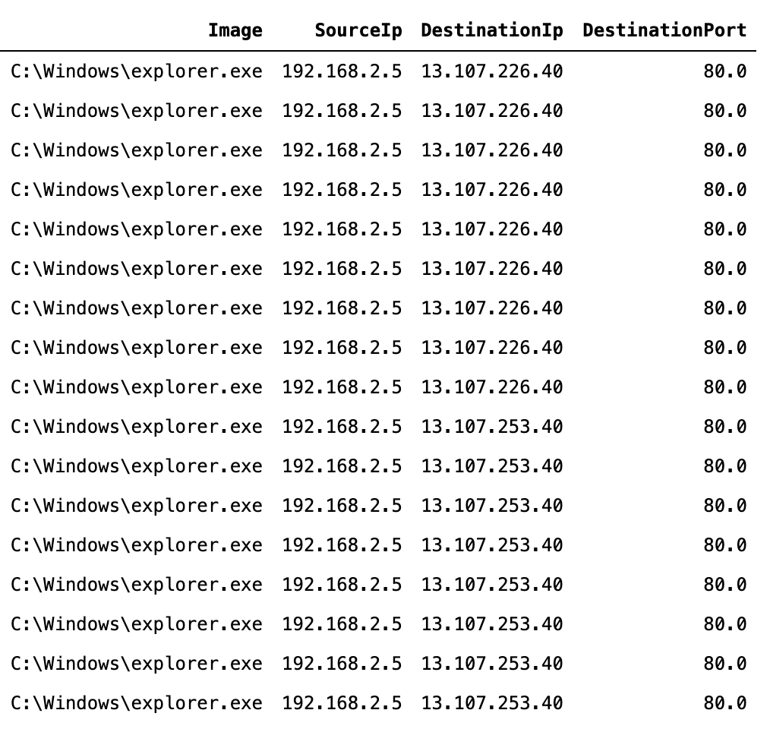
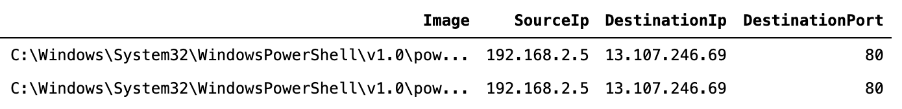
5) Looking for Network Connections
Test 2: Sysmon event 3 (Network Connection)
Test 3: Sysmon event 3 (Network Connection)
We need to validate if these ip addresses are malicious or not…

Slide 67


Wait ...

Slide 68
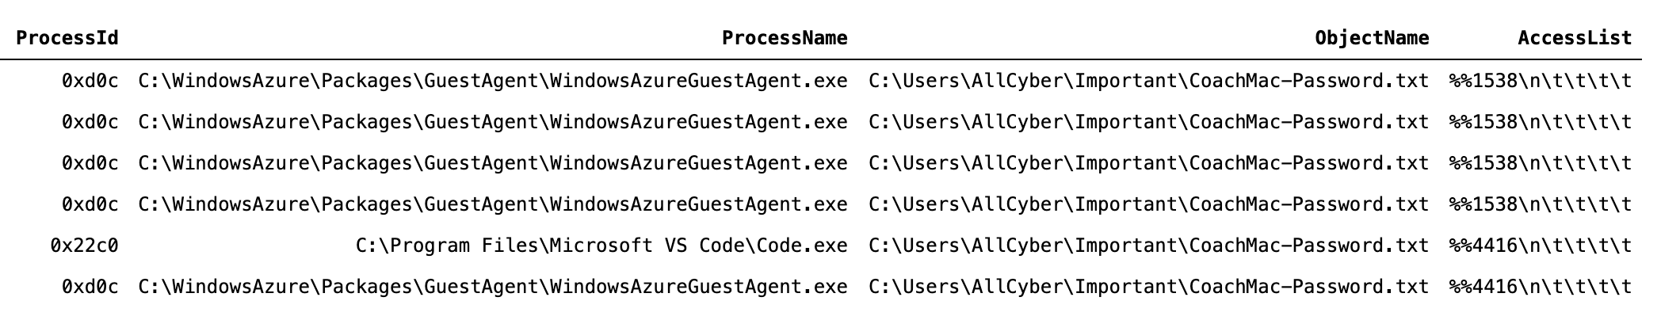
Access to CoachMac-Password.txt file

Slide 69
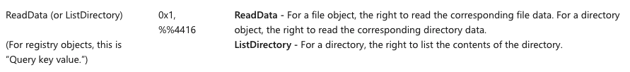
Access to CoachMac-Password.txt file
Access Rights:

Slide 70
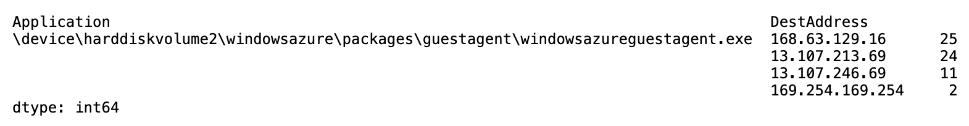
Access to CoachMac-Password.txt file
Do we have a network connection from ProcessId = 0xd0c ??

Slide 71
Lessons Learned
What can we do better next time?

Slide 72
What have we learned?
Tests 1 and 2:
Maximum Size of log files: 0
Persistent collection mode was required
SACL definition was required
Using Machine / System scope for profiler DLLs makes detection simple because is too noisy.
Test 3:
Using Process scope for profiler DLLs makes detection complicated
Using services that start before telemetry tools impacts the data analysis process
Two layers of defense: COR_PROFILER behavior (Bypassed) and SACL (Added important context) for relevant data.
Tests 1, 2 and 3:
Tools used: Security Auditing, Sysmon, System, Event Trace Logs
Need to learn about more tools: Process Monitor, Process hacker, etc
Need to prepare a PowerShell script to expedite the configuration of la environment, specially when not using Azure Sentinel To-Go.

Slide 73
What topics have we covered?
Topics for future presentations or series of presentations

Slide 74
Presentation Topics
CLR (Common Language Runtime ) for .NET Applications
Profiler DLL (Dynamic-Link Library)
Environment Variables
Windows Registry Keys and Values
Types of Values
ACL (Access Control List)
DACL (Discretionary Access Control List)
SACL (System Access Control List)
Research Hypothesis
Data Dictionaries
Host data: EVTX files
From EVTX to XML → From XML to Pandas Dataframe
Network data: Event Trace Logs files
From ETL to PACP → From PCAP to WireShark
Python for data analysis
Collection / Transformation / Filtering / Correlating / Visualizing

Slide 75
Thank You

